Slide 1

Entertainers Data Analysis

Slide 2

Objectives
Find youngest Male and Female Entertainer at the time of Breakthrough
Which year has the most breakthroughs
Gender distribution of alive Entertainers
Entertainers with longest and shortest active years

Slide 3




The Process
Data Collection
Data Cleaning
Data Analysis
Insights

Slide 4

Data Collection
The Data has been collected in the form of three xlsx files
The files contains the information about famous Entertainers/Artists

Slide 5

Data Cleaning
Combined all three xlsx files into a single table using VLOOKUP
Column ‘Year of first Oscar/Grammy/Emmy’ has some blank spaces. Relaced them with NA.
Column ‘Year of Death’ has some blank spaces. Relaced them with a placeholder ‘Still Alive’.
Created a new column ‘Age at Breakthrough’ which is ‘Year of Breakthrough’ minus ‘Birth Year’.
Created another column ‘Active Years’ which is ‘Year of Last Major Work’ minus ‘Year of Breakthrough’

Slide 6
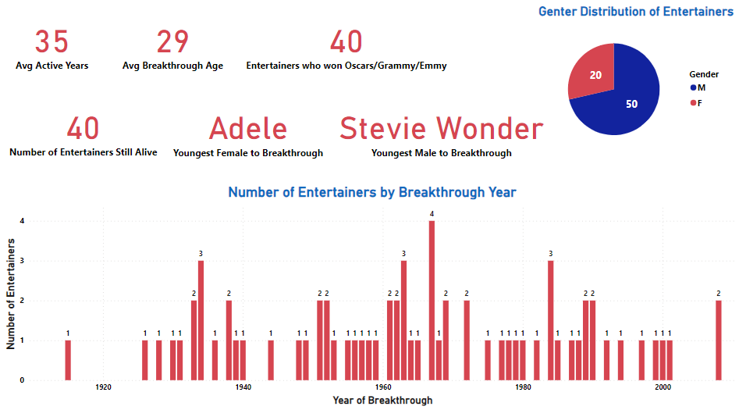
Data Analysis

Slide 7
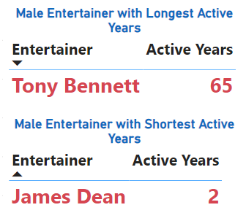
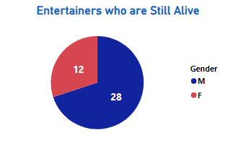
Data Analysis

Slide 8
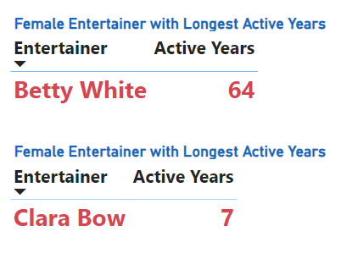
Data Analysis

Slide 9
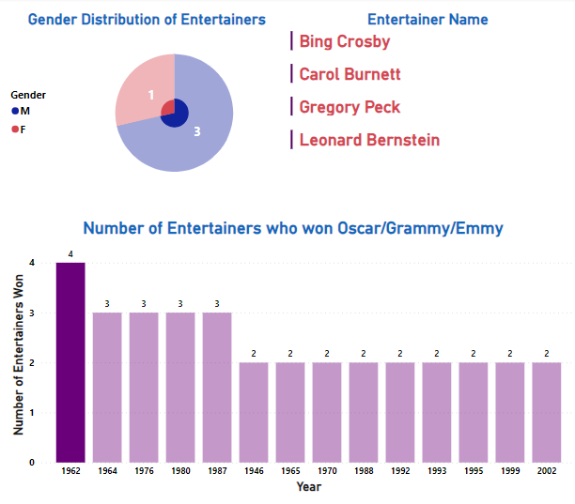
Data Analysis
Year 1962 had the highest number of Entertainers to won any Oscar, Grammy or Emmy

Slide 10
Insights
Out of 70 only 40 Entertainers had won the Oscar, Grammy or Emmy awards.
There are 20 Female and 50 Male Entertainers.
Only 40 Entertainers are still alive.
Adele was the youngest female Entertainer with an age of 20 at the time of her breakthrough.
Stevie Wonder was the youngest male Entertainer with an age of 13 at the time of his breakthrough.

Slide 11
Insights
Year 1967 had the most breakthrough at 4 Entertainers
Out of 40 Entertainers who are still alive, 12 are female and 28 are male.
Tony Bennett was the most active male Entertainer with 65 years. While James Dean was the least active male Entertainer with only 2 years.
Betty White was the most active female Entertainer with 64 years. While Clara Bow was the least active female Entertainer with 7 years.

Slide 12
Insights
Year 1962 has seen the most win of 4 Oscars/Grammy/Emmy.
Bing Crosby(M), Carol Burnett(F), Gregory Peck(M) and Leonard Bernstein(M) had won the awards that year.

Slide 13

Thank you
Vishal Morya

